Slide 1
Airbnb Experiences
~ Himanshu Wankhade
~E23CSEU0380@bennett.edu.in

Slide 2

Problem Statement
You are a PM for Airbnb and you are planning to launch AirBnB Experiences.
Deﬁne all the metrics required to track the performance of the feature.
Include the Events you will track as well as Event Design format.
How will you know if this feature is a success?
If the feature launched does not behave as expected, how do you react?

Slide 3
How many times do you explore beyond our typical stay?
Now gather stories and Experience the Locale

Slide 4

Choose best Experiences!
(Now introducing unique activities online)
Local Experts
Led by locals who love where they’re from and what they do.
Small Groups
With intimate group sizes, you’ll never get lost in the crowd.
High Standards
Every experience in reviewed for unique access.
History & Culture
Art Gallery
Fun & Party
Food
Sports
Nature
Health

Slide 5

Meet the traveller- Katherine
She is a student of history.
Recently took a semester off to write a paper on certain indegenous civilizations. Excited to ﬁnd different places and culture.
As a culture enthusiast she’s always looking for authentic experience.
AirBnB - Ex
Willing to pay for real and exciting experiences. Facebook is her main source for ﬁnding nearby events.

Slide 6
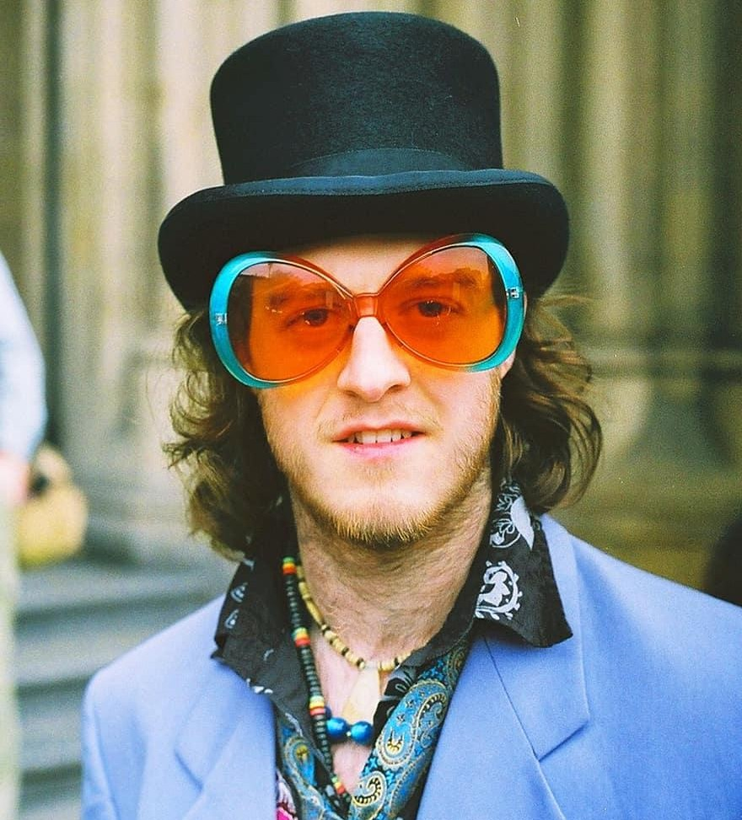
Meet the host - DJ Marcos
He recently opened a fascinating record store set inside the home near the beach side in Havana.
Visitors to his store, mostly tourists, from different nationalities enjoys his cuban music. The idea is simple to enjoy modern music surrounded by the local music history & culture.
AirBnB - Ex
Oﬀers 100% covid safety with only 10 people allowed in a span of 6 hours..

Slide 7
1. Acquisition
Airbnb Experiences are curated to grab the audience’s attention right from the start to explore and experience activities, led by local experts around their unique stay.
Instagram + other social media To Highlight new & surprising activities on social media- #large volume
Stories around emotions
Give people a reason to stay more on website - #more bookings
Message
A simple message of ‘creating and sharing experiences’ in local - #more impressions

Slide 8
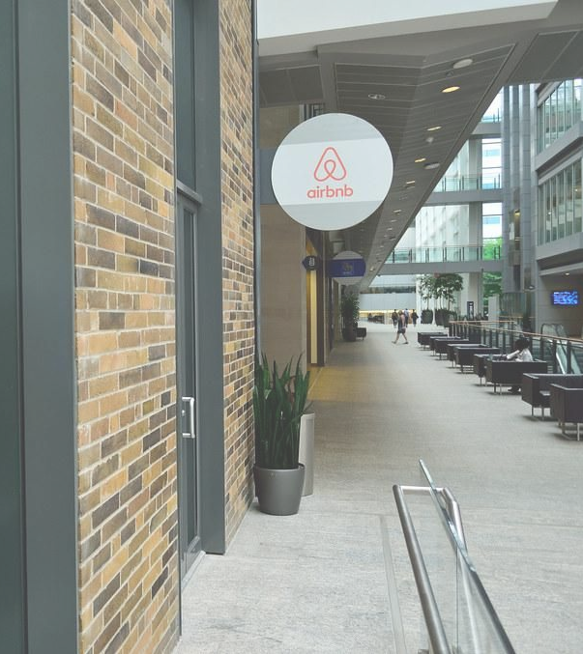
More than 50 million Americans travelled abroad in last 5 years
THAT’S MORE THAN THE
POPULATION OF
CALIFORNIA AND
TEXAS COMBINED
AirBnB - Ex
AirBnB demographics stats project 45.6 million users by 2022.
Such Huge user-base can be leveraged by pushing AirBnB experiences model.
Source: statista

Slide 9
2. Activation
By making sure users are ﬁnding the activities they like.:
What
What number of users made an account on Airbnb?
Who
Who among the active vs new users are booking the experience for ﬁrst time?

Slide 10
Millennials are more likely to stay in locals for experience and social media worthiness.
Over 86% travellers ﬁnd the location of AirBnB more convenient than a hotel and
easy to explore the
AirBnB - Ex
Guest/Users of airbnb are more likely to be millennials who agree that home-sharing is more open to cultural experiences.
destination.
Source: capital stats survey

Slide 11
3. Retention
Users need to come back again, to reduce churn .Frequent visitors are more likely to book experience.
3rd metric is just to see user stickiness, and as a potential customer.:
Search
# of users searching for experiences
2nd timer
# of users booking their second experience
Repeater
# of users paying monthly 5+ visits

Slide 12
AirBnB’s P2P business model has been very aﬀordable for users to stay in stylish properties.
More than 750 million travellers & 2.9 million hosts across the world.
AirBnB - Ex
One of the world’s biggest community, AirBnB in 2019 revenue hits all time
Source: capital stats
record for USD4.7 billion.

Slide 13
4. Revenue
To focus on building user-base around product. More users means more business.
Milestones
# of users completing 1st successful payment of 1st airbnb experience.
Testimonials
# of tickets sold per curator.
Upgrade
# of users buying more activities during current experience.

Slide 14

Expert in your local culture? Make AirBnB Experiences
even better by joining the community
AirBnB - Ex
Inspire and reach out to more travellers. Provide the audience with accurate local culture & information
A typical AirBnB hosts earns $1000 per month on an average across the globe.

Slide 15
5. Referral
To create strategy around the product, so active users/hosts attract new users/hosts..
Storyboard
To compile activities of users aesthetically, which they can share on social media’s. Thus attracting more new users via storyboard.
Reviews
# of users converted by review/referrals/recommendations
Active user Journey
# of users renting stays and then booking experience and vis-a-versa.
# of new hosts added from traditional entertainment industry

Slide 16




Metrices
North Star Metric
#Experiences Booked per user
Behaviour Metrics
#New users
#searches for experiences city vise.
#searches for experiences host vise.
#clicks on popular experiences.
#searches based on location + date
Revenue Metrics
#successful payments
#average ticket size for experiences.
money earned from experience host.
money spent on creating activities.
Total revenue generated by stay+experiences.
Success Metrics
#Refferrals+bookings
#New Experiences added & booked
#Repetition of experiences by same user

Slide 17
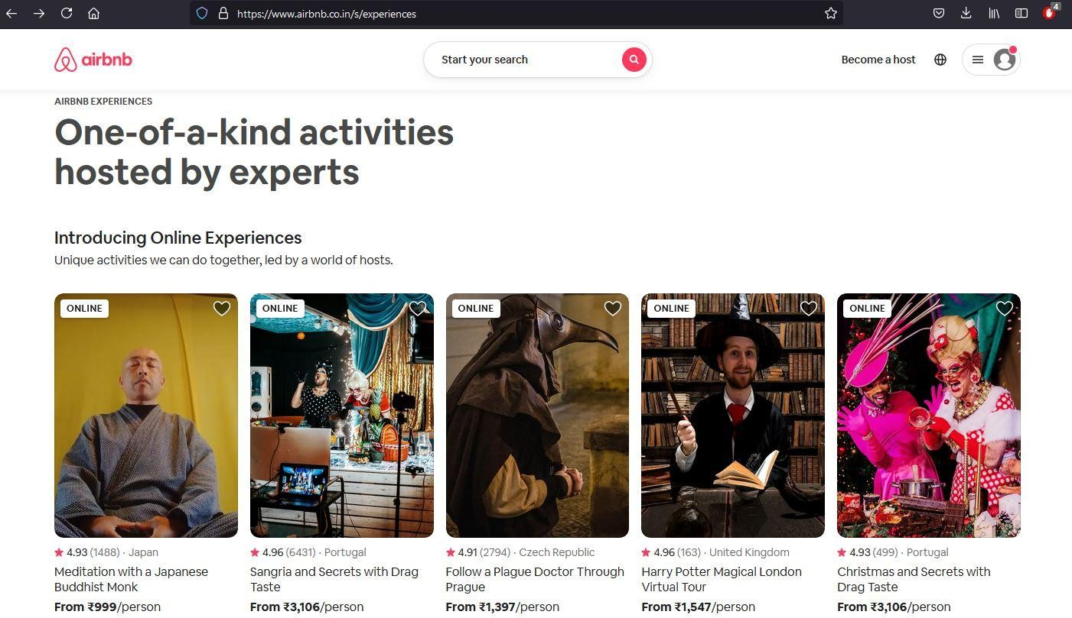
Event Design
Users enter Experiences and clicks search.
No. of clicking nearby locations
No. of entering text location.
To Start Tracking the user journey who clicked experiences. Measure easiness to add/eliminate feature

Slide 18
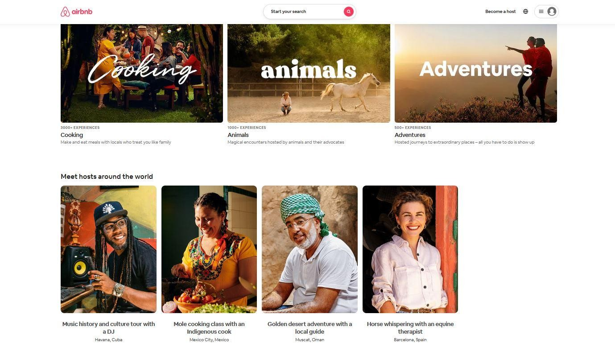
Event Design
User sign-up/login, help
Behaviour metrics: Top Category Filter
Behaviour metrics: Select Hosts (type), Select city,
Select activity

Slide 19
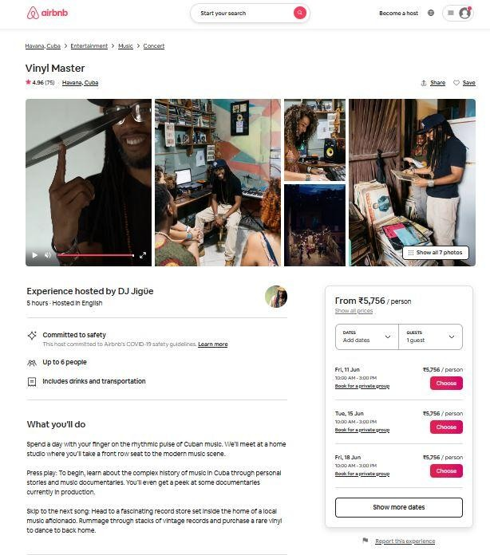
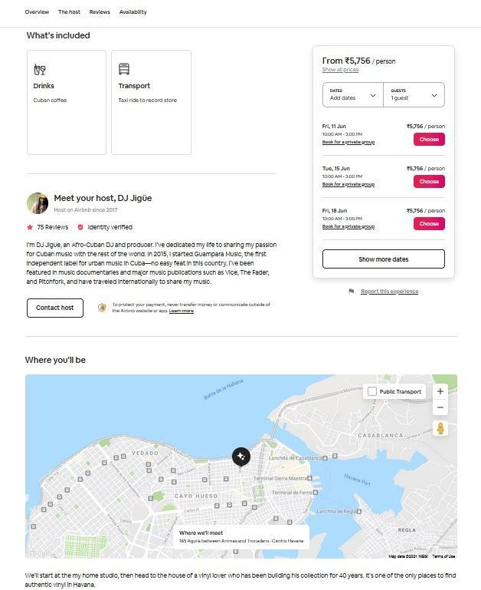
User clicks to become host
User selects Category Filters
User selects share and save
Rating, Description of host and overview of services provided
User clicks on map to locate destination
Activity/experience description
Processed to select date, no of guests and pay. This closes the funnel of user from selection to payment.

Slide 20
1. Idea
Goal: To promote AirBnB Experiences as an online + ofﬂine marketplace.
Build idea: Connect people with rented properties and locale businesses with travellers/customers
To Leverage AirBnB strong digital presence
which currently stands at: Twitter - 725K+ Instagram - 5 Million+
Prioritise building features around digital media to increase number of new Experiences booked.

Slide 21
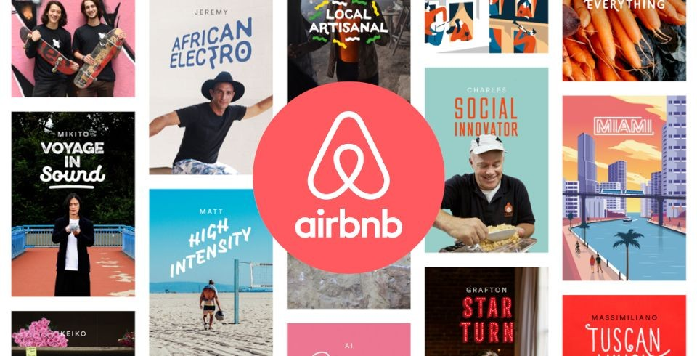
Storyboard & Byte sized vids
>The idea is to create something that lets users know the kind of variety of Experiences that AirBnB offers.
>Compilation of all the unique memories and collectibles of the user during an activity or experience should be presented as a shareable storyboard,video this provides a greater audience
>The infographic will act pivotal in getting new customers to buy the activity/experience

Slide 22
2. Hypothesis
>To Build a aesthetic storyboard feature with real time byte sized stories of travellers who completed the activity/experience.
Contains:
IF: Improve the algorithm to boost real time traveller/user review.
Then: Target new users are more likely to book experiences. (%)
Because: Create Traveller based local Community & increase in engagement of users and hosts.

Slide 23
3. Experiment
Primary Metric: Number of Review videos watched (PU) Number of experience booking made (PU)
Create real time user/traveller reviews to increase bookings signiﬁcantly.
The current review section will be changed into storyboard and byte sized stories just like one for hosts.
Beneﬁcial for new users and 1st time experiences subscribers. Ease of action
Personalized Storyboards & byte sized videos will help users to judge the event/activity and choose best for it, by following hashtags.

Slide 24
4. Result
The feature experiment is made to run only to test the number of new bookings of experiences.
The consumption of traveller/user review will affect these:
More time spent on experiences page.
Increase in Number of new experiences booked by user.
Number of DAU, MAU (increases)
Number of Site visits (increase)
Rebooking of experiences due to FOMO(increases)

Slide 25
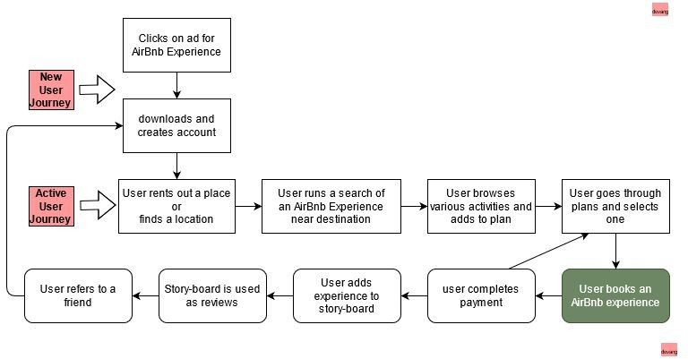
Measure Success
AirBnB Experiences success is driven by the increase in the number of experiences booking per user, thus focusing on North Star Metrics.
Number of new user get through this ideal steps of the funnel.
Users discover experiences of their choice, tracked via number of storyboard hashtags it follows.
More users signing up on the platform and increase in num. of users visiting on experiences page.
More successful payment completion, closing of funnel.
>More num. of 2nd & repeated bookings.
NO
Y

Slide 26
Problem Statement
What?
>Before launch, Engineering team identiﬁes a bug, which causes 10% failure of payments while booking an experience
~ should we go ahead with the launch.

Slide 27
Launch Decision
Let us assuming that the team has completed market research , validation of product is completed, viable metrics are open to track and all further team communications are completed. As this bug occurred just before the launch. Certain above stated factors points that this feature is a result of months of structured thinking and collaborations among all internal stakeholders. We will start with ﬁnding the reason behind failed payments.
Check how recent is the failure has recorded?
What speciﬁc payment gateway has high failure rates?
To check for speciﬁc location and mobile/desktop failure.
This way we can narrow down and ﬁnd the root cause of failed payments. After ﬁnding the root problem we will mitigate with the engineering team to create a workaround task and ﬁx a deadline at the earliest.
we should restrict the payments to the most successful gateways.
Flash alert messages to user in case of failed payment and provide support.
Roll out the launch of the feature according to the deadline. 4.Update the bug in the next version launch.
Thus with understanding the priority of launching the product features, there's a higher % of successful payments which will obviously add to the revenue. So, i would discuss and go ahead with the launch.

Slide 28
The End

